Slide 1


Summer Internship Project
DATA DRIVEN FRAMEWORK FOR PREDICTION OF FISH CATCHES IN NORWAY USING MACHINE LEARNING TECHNIQUES
Submitted by – Mrinal Yadav
18NA10018
Undergraduate student, Ocean Engineering and Naval Architecture, IIT Kharagpur, India
Under the supervision of -
Prof. Dr. Ekaterina Kim
Department of Marine Technology, NTNU,
Høgskoleringen 1, 7491 Trondheim, Norway

Slide 2

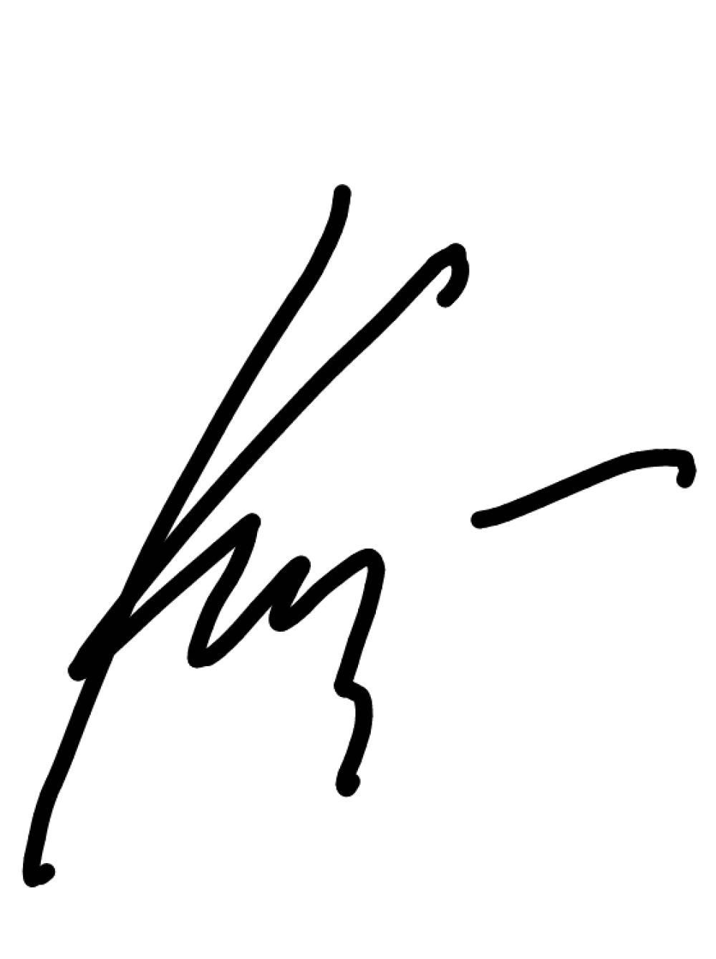
To Whom it May Concern,
As an associate professor in Arctic Marine Technology at the Norwegian University of Science and Technology (NTNU), Department of Marine Technology, and a member of the ISSC committee on Ocean Space Utilization, I have had the pleasure of mentoring Mrinal Yadav from 05.2021 to 07.2021 during his online internship at NTNU within AI for multi- scale data processing, fusion, and uncertainty estimation. I am happy to provide Mr. Mrinal with a general recommendation letter.
Mr. Mrinal is a dedicated and hardworking person with a good knowledge of programing languages, especially Python. He has an aptitude for data analysis and seems to pick up any coding related work easily. During the internship Mr. Mrinal performed analysis of fish landings, implemented several machine learning models for catch prediction, and critically assess the results. He was found to be proactive, punctual, and inquisitive who demonstrated a good work ethic and interpersonal skills. He carried out all the research tasks that were assigned to him and completed the work within the mentioned deadlines. During the internship, Mr. Mrinal demonstrated independent thinking skills and strong interest in the topic being studied and is currently writing a journal paper based on the findings.
I see a bright future for him and hope he will be granted the opportunities he deserves. Do not hesitate to contact me for any reason.
Sincerely,
Ekaterina Kim, PhD
Associate Professor, Onsager Fellow Department of Marine Technology, NTNU
Member of the International ISSC Committee on Ocean Space Utilization

Slide 3
ACKNOWLEDGEMENT
I would like to take this opportunity to show my greatest gratitude to my supervisor Professor Dr. Ekaterina Kim, Norwegian University of Science and Technology, Trondheim, Norway for giving me the golden opportunity to do this internship under her supervision and for her constant encouragement, guidance and attention during this whole project. She always showed great interest in providing timely support and suitable suggestions. At times when I encountered roadblocks during some portions of the project, she helped me pave the right path forward and lead to a successful execution of the project.
I also want to thank Bjørnar Brende Smestad, NTNU for his constant support and for taking support in useful decisions, giving out necessary advice and guidance. I express my special gratitude to him as well for providing me with the explanation of the data as required by me.
I perceive this opportunity as a big milestone in my career development. I will strive to use gained skills and knowledge in the best possible way, and I will continue to work on their improvement, in order to attain desired career objectives.

Slide 4
Table of contents
 | Content | Page no.
 | Letter of Recommendation | 2
 | Acknowledgement | 3
 | Table of contents | 4
 | Introduction | 5
 | Preprocessing of data | 6
 | Analysis | 20
 | Modelling | 24
 | Feature Engineering | 28
 | Result and discussion | 31
 | Conclusion | 34
 | Reference | 35

Slide 5
Data-Driven Framework for Prediction of Fish Catches: A Norwegian Case Study
Introduction
In this project we are analyzing the past 20 years data in order to do catch prediction so that a new vessel with different parameters can be given instructions on when , where and how to fish to get the maximum catch possible.
First we will do the data preprocessing as the data has many discrepancies like Nan’s, handling missing values ,wrong formats and abnormal data(values that cannot be possible).
Once the data file for individual year is handled we combine all the data for 20 years for further regression modelling using tree based methods. On the combined data we do analysis.

Slide 6
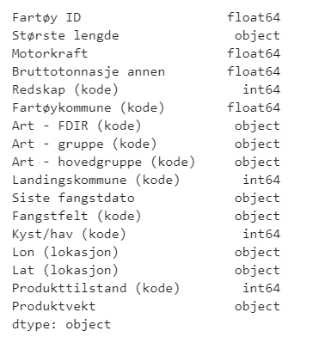
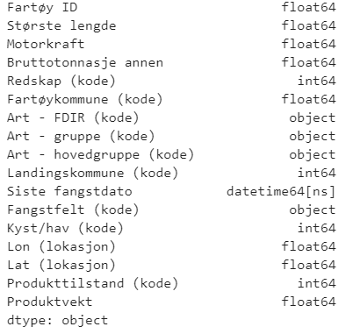
Preprocessing the individual files(eg-2001)
Read the data(2001) - Initial shape: (1213767,133)
The data has to be read such that certain code formats were preserved, for ex the species code (01220) when read gets converted to 1220 so the essence is lost. So they were read in string formats.(data-2001) – only certain important columns taken for analysis. This image shows the important columns and their datatypes for further analysis.
As we can see that there are 4 columns that still need modification in their formats that are length and catch date and latitude/longitude. We need to convert length to float , catch date to date-time, latitude/longitude to float and product weight to float format format so we did.

Slide 7
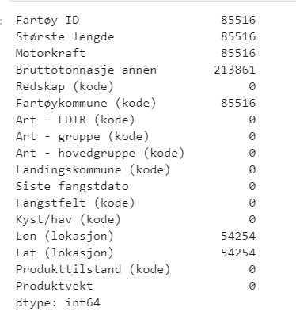
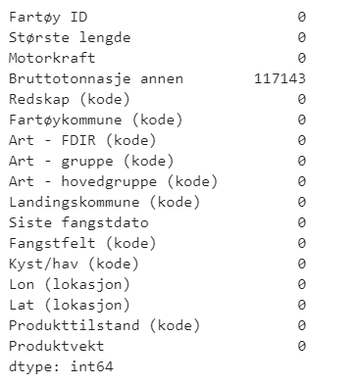
The Nan values:
So there were many data points that were nan which meant they had no information for that place. For the important columns we can see this distribution from the following image.
As we can see that certain columns had no nan values but the ones that did were having some pattern. 4 columns have same number of nans so when we removed them we observed they belonged to the same row indexes hence after removal of those entries all 4 columns were handled at once. (Remove entries where vessel id = nan)
For latitude and longitude we remove the entries where longitude = nan and the latitudes were handled automatically.
Regarding the tonnage column , we have to deal with imputation strategy because of 2 reasons:
1. There is no such pattern visible.
2. We cannot remove such high amount of data , it will result in information loss.

Slide 8
Dealing with zero values: (problem in data)
Dealing with zero values in tonnage column: (problem in data but solvable)
We try certain checks for the tonnage column like if any value is zero or negative (which is actually not possible). we find no value to be negative however we find that there are certain entries where tonnage is zero.
Now there are two columns for tonnage in each year data – tonnage 1969 and tonnage other. We find that tonnage 1969 has about 90 percent of entries as nans so there was no point keeping this column however tonnage other had just few entries as nans as compared to tonnage 1969 so we keep it. All our analysis was based on this column – tonnage other.
Now we observe that certain entries in this column are zero which is practically not possible so we check . So we replace the entries in those places with the entries with corresponding index from the column tonnage 1969.
Dealing with zero entries in power column: (problem in data – unsolvable)
Also we observe that there are entries where engine power column has zero values , but since there was nothing to replace and the number of such entries is very small(0-10) hence we remove them.
Dealing with zero entries in product weight column: (problem in data – unsolvable)
Also there are entries with product weight equal to zero since we cannot do much about them so we remove these entries.

Slide 9
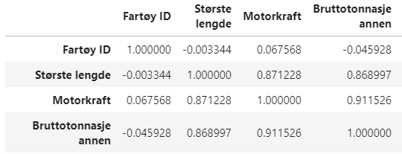
Relationship of technical parameters:
Based on the correlation coefficients we see that length , power and tonnage (technical parameters are highly correlated to each other .
As we see that correlation between all three is pretty high and almost the same hence we can use any of length or power to impute tonnage values.
Based on the article: (19) (PDF) Relationship between Gross Tonnage and Overall Length for vessels on the ICCAT Record: Implications for Unique Vessel Identifiers (researchgate.net)
We decide to go with length to impute the tonnage values.

Slide 10
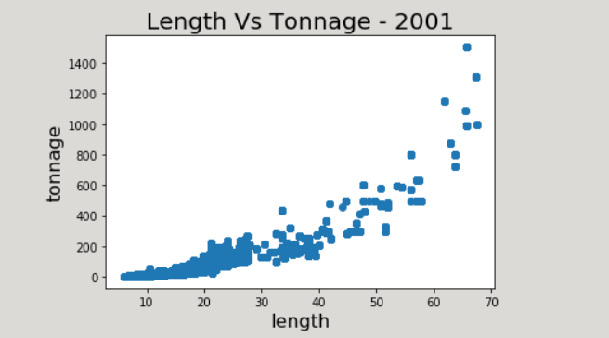
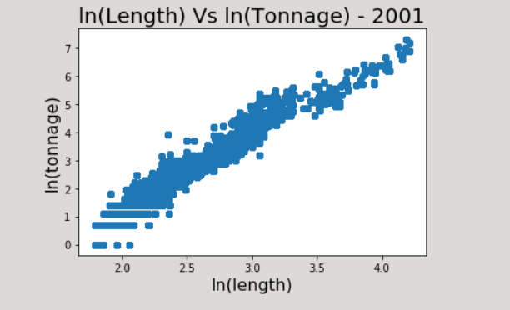
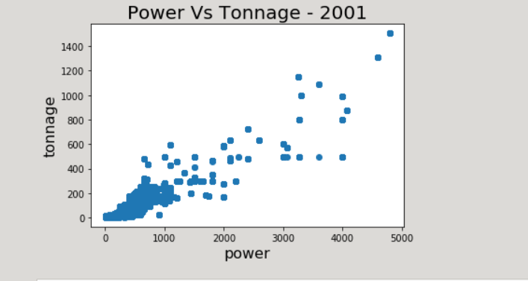
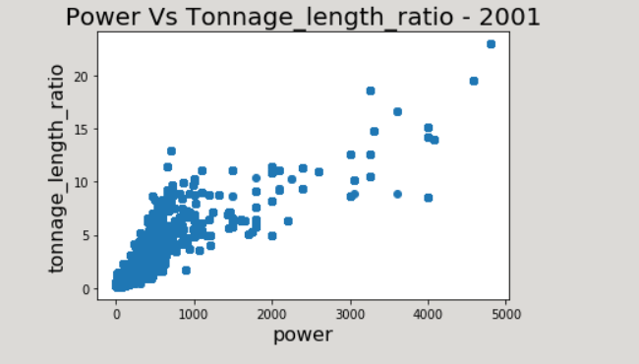
General overview of length, power and tonnage relationship for year - 2001

Slide 11
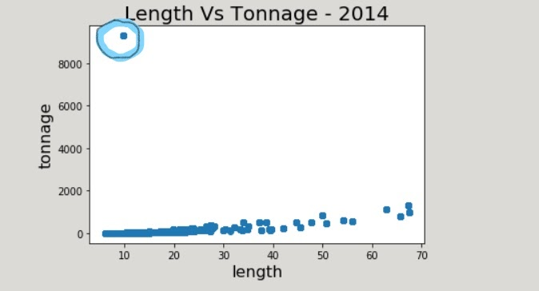
Solving abnormalities
As we go by the years we see some general trend being followed but we also see some abnormalities.
The length vs tonnage plot is logarithmic
All years generally follow the same trend but the years 2014, 2015, 2016 follow somewhat different trend because of some vessels with abnormally large values of tonnage.(greater than 8000 that too for small vessel of 10-20m range).
The general trend is somewhat like below:

Slide 12
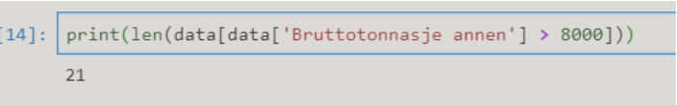
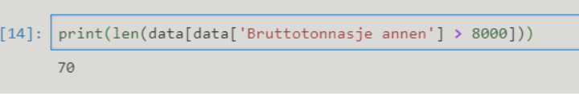
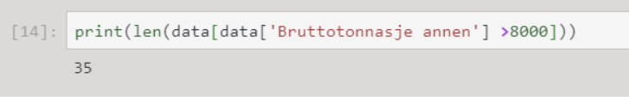
Cause of abnormalities:
For 2014 data this is caused by 21 entries belonging to the same vessel:
For 2015 data this is caused by 70 entries belonging to the same vessel:
For 2016 data this is caused by 35 entries belonging to the same vessel:
Vessel name: CHRISTINA
Tonnage given: 9.65m
Length given: 9300.0
Vessel name: CHRISTIN
Tonnage given: 9.65m
Length given: 9300.0
Vessel name: GLESEN
Tonnage given: 9.65m
Length given: 9300.0

Slide 13
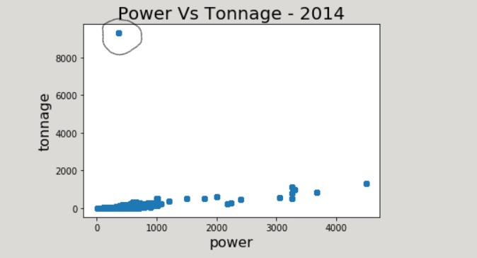
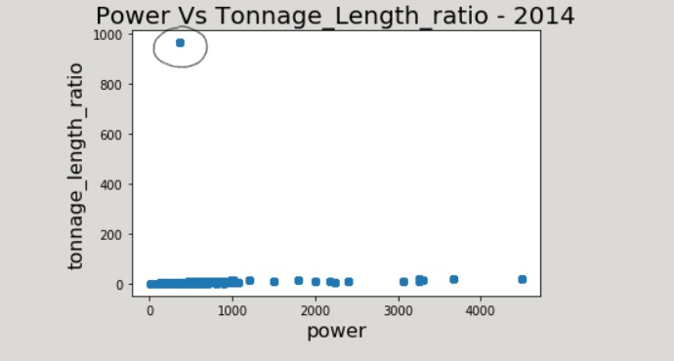
Because of these ships the plots of power vs tonnage and tonnage_length_ratio vs power were also affected for the years 2014,2015,2016.
General trend of power vs tonnage:

Slide 14
Further analysis:
In the year 2014 there are total of 282 vessels named ‘CHRISTINA’.
But the length for all 282 same named vessels is not same . It has 4 values of length in which for 3 value tonnage is given and for remaining 1 it is nan.
For 7.2m - tonnage=3.0
For 8.26m - tonnage=11.0
For 9.65m - tonnage= 9300.0 (Abnormal 21 entries)
For 10.65m - tonnage=nan
In 2015 data there are a total of 297 vessels named ‘CHRISTINA’.
But the length for all 297 same named vessels is not same . It has 4 values of length in which for 3 value tonnage is given and for remaining 1 it is nan.
For 7.2m - tonnage=3.0
For 8.26m - tonnage=11.0
For 9.65m - tonnage= 9300.0 (Abnormal 70 entries)
For 10.65m - tonnage=nan
In 2016 data there are a total of 35 vessels named ‘GLESEN’.
All 35 entries have same length-9.65m and tonnage = 9300.0
Solution: Replace 9300.0 by 9.3

Slide 15
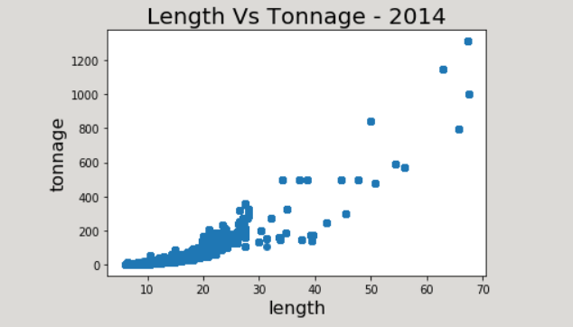
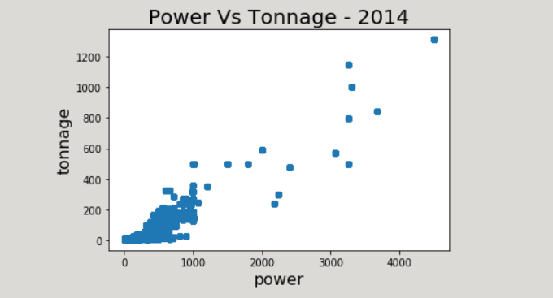
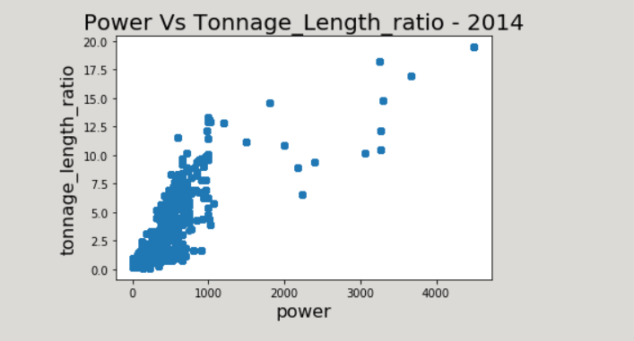
After replacement: 2015 and 2016 also have the same general trend.

Slide 16
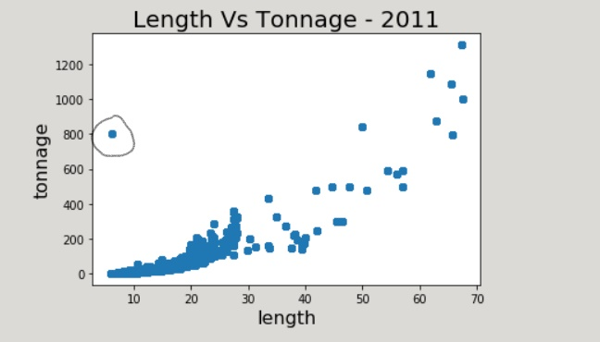
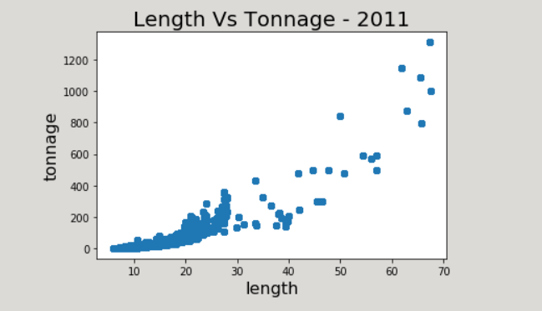
One more abnormality in 2011 data:
As we can see that there are certain points that are affecting the trend.
This is because of 4 entries belonging to the same vessel:
Vessel name: VIOLETA
Length given: 6.1m
Tonnage given: 800.0
In complete 2011 data we have only these 4 entries of vessel named VIOLETA , so we don't have much information here regarding this.
So the best option regarding these entries is just to remove them.

Slide 17
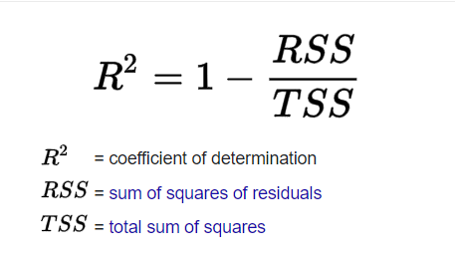
Imputation of tonnage :
At this point we just have nans with tonnage that we need to impute with the help of length.
The general relationship between length and tonnage is logarithmic as evident from the plots for all the years. So we assume a general log-linear relationship between them and try to find the best possible curve that fits it.
The relation that we use is :
ln(tonnage) = a*ln(length) + b
For each year we find these coefficients (a,b) that best fits that years data. We measure the extent of good fit through the R-squared score.
R-squared is a statistical measure of how close the data are to the fitted regression line. It is also known as the coefficient of determination.

Slide 18
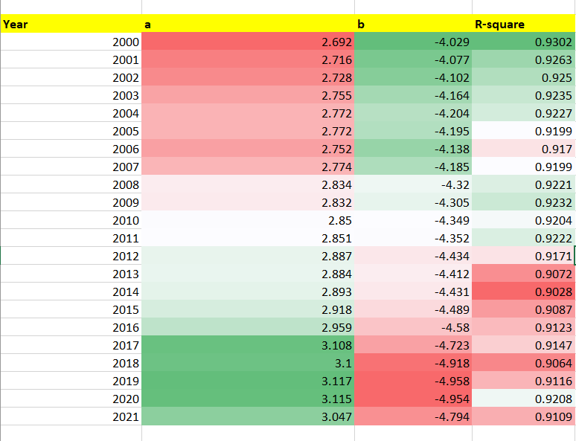
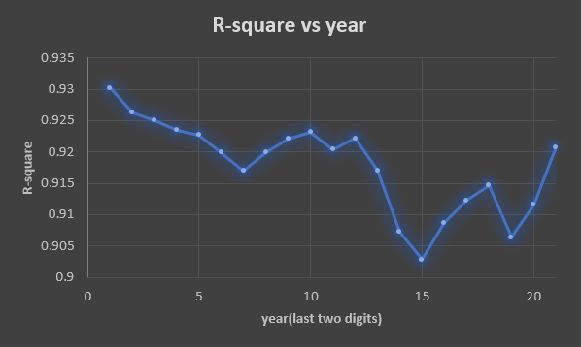
Curve fit results: ln(tonnage) = a*ln(length) + b
As we see that we get different coefficients for each year but the ranges are limited to particular integers.
From the graphs we can visualize the ranges directly and also see that
R-squared score are pretty good indicating they are good fits.
So we use these coefficients in the general relation to impute the tonnage values wherever they are nan.

Slide 19
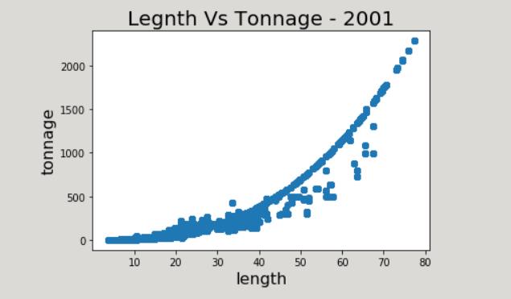
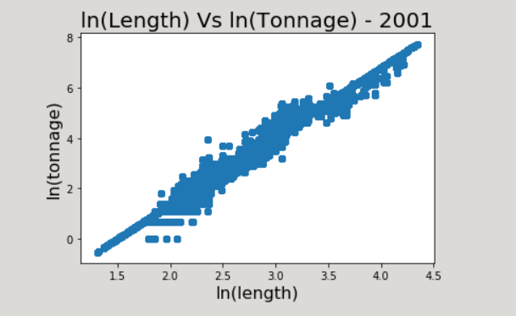
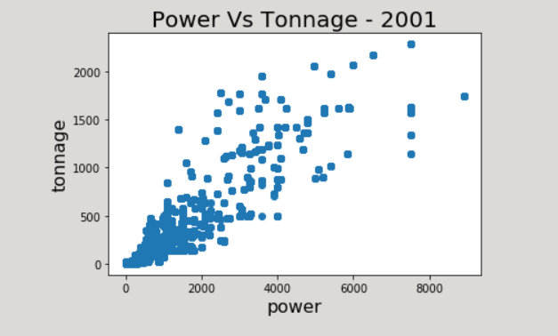
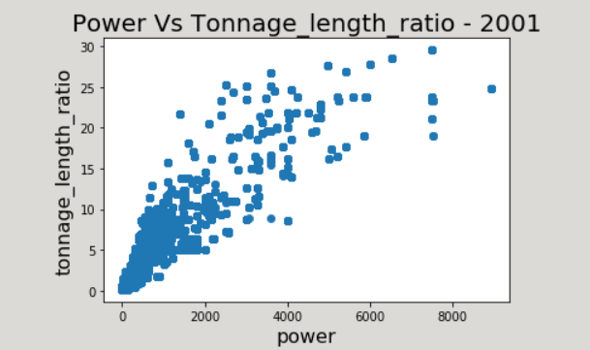
General plots after imputation: All years had the same trend as follows

Slide 20
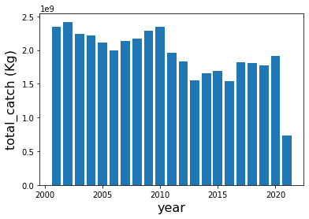
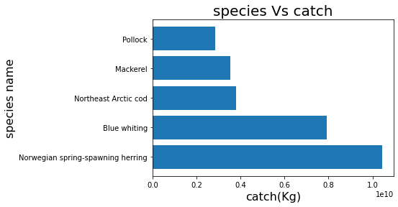
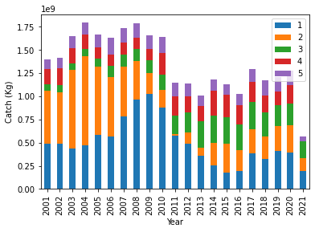
Elementary Analysis :
We have performed elementary analysis on data (complete with cleaning) and then did clustering of complete data this is just to get an idea of what the data clusters might look like with respect to parameters like vessel length and the species of fish.
Since the data is cleaned to a certain level, we perform cluster analysis where we cluster the vessels based on the characteristic that might affect the catch. For purpose of analysis, we will be considering top 5 species (180 total species) with respect to catch.

Slide 21
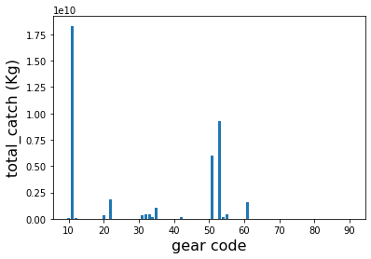
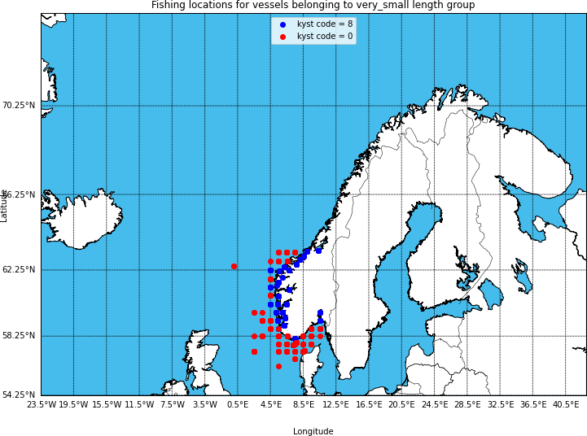
Analysis continued
Moreover, we can infer that certain gears/tools have been excessively used for fishing and hence have caught more fishes than other tools.
shows that the gears 11, 51 and 53 have caught the most fish over the past years. They correspond to the following gears – 11: Purse seine; 53: Floating trawl and 51: Bottom trawl.
In our analysis there are 239 unique fishing locations (cleaned data) out of which 151 locations are in the north model and remaining 88 locations are there in the south model and here in this paper we focus on the south model .
the fishing location for south model. As we move away from the coast the sea depth will start to increase making the water waves to be high and more dangerous for fishing.

Slide 22
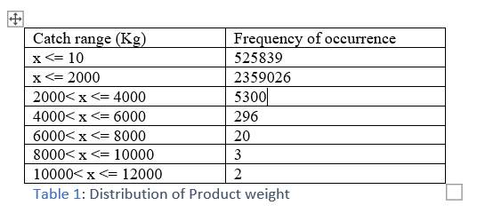
Some more data preprocessing: Preparing data for input in model
we have analyzed specific group of vessels (length lesser than 10m) and species (specific codes for cod fish). We created two more column namely gear code frequency and product condition code frequency which indicated the number of times a particular gear/tool was used and the number of times the product had a particular condition respectively.
We have removed those entries where the frequency of gear code and product condition code was less than 1000 to handle outliers. We observe that the catch is a very dispersed value. We calculated the number of times the catch was in a particular range and got the following results.
as we see that the distribution is quite dispersed, making certain ranges act like a outlier(noise). Hence, we just consider the catch from 10kg to 4000kg.
Now we divide our data into 2 parts based on longitudes and latitudes, we call one the south part and the other one the north part. In this paper we discuss the south part of data. We take the range of latitudes and arithmetically divide it into south and north. This south part is essentially the fishing locations in the North Sea .

Slide 23
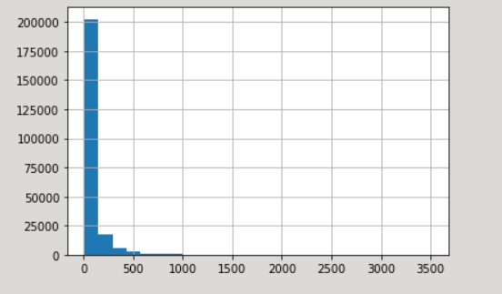
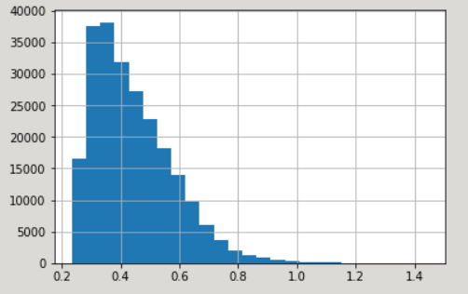
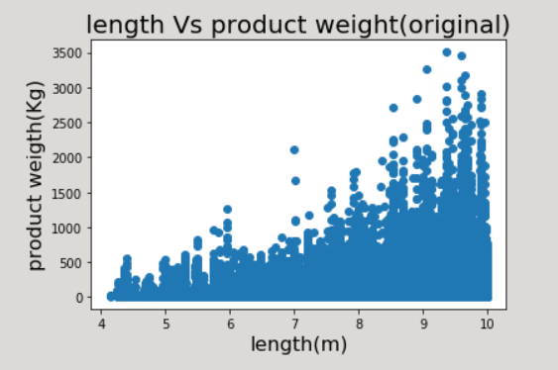
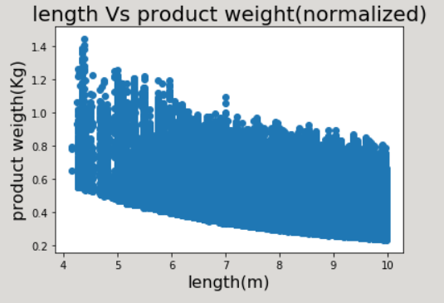
Analyzing target variable: product weight
The target variable has high variance as evident from the figure.
While decision trees have a natural resistance to outliers, boosted trees are susceptible, since new trees are built off the residual. Hence, we apply a log transform to our target to have good predictions from the model.
Transform of target variable:
Product weight → log (product weight)/length

Slide 24
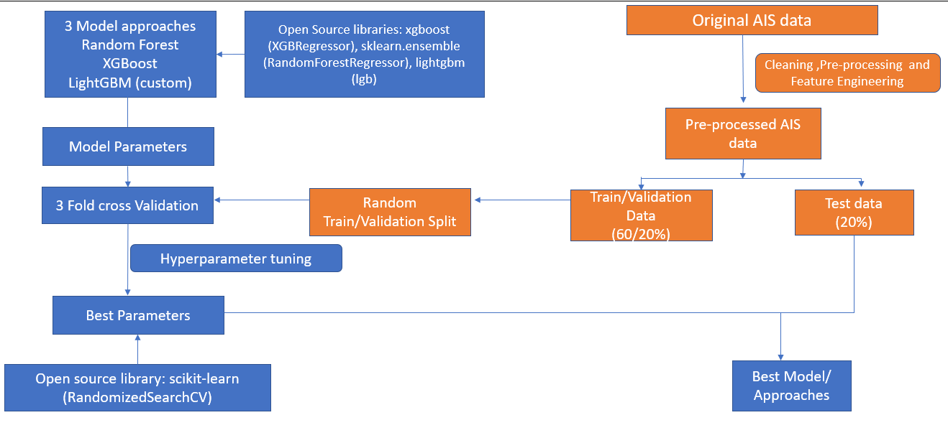
Modelling Approach:
In this study we have considered the following factors that can contribute to change in the product weight: vessel length, gear/tools for fishing, fishing location, target species, product condition, month, season and distance from North Sea. The task is to investigate how accurate we can predict product weight given these conditions.

Slide 25
Theory behind models and custom functions
We have systematically explored predictive capabilities of three popular supervised machine learning approaches such as Random Forests , XGBoost (EXtreme Gradient Boosting) and LightGBM which are recognized for predicting patterns in data and admirably on tabular datasets.
In case Random Forest and XGBoost algorithm we have used the default custom objective and custom evaluation function while in case of LightGBM algorithm we have made and used our own custom objective and custom evaluation function.
we can have two types of incorrect predictions, overestimated predictions and underestimated predictions. In case of default loss function both of these incorrect predictions would have been penalized equally however we don't want that because in our case if we have the overestimated prediction and the fisherman is not able to fetch the predicted amount of catch in accordance to which he had earlier done investment , then it will lead to the loss of fisherman and we don't want that , so instead of giving equal penalty to both kinds of incorrect predictions we give more penalty to overestimated predictions and lesser to underestimated predictions because this cannot lead to the loss in any case unlike overestimated predictions . so, we design our custom loss function in a similar manner.
Any loss function for a regression problem is based to optimize on mean squared error, so we multiply the error by the penalty factor for each error. The penalty factor we use is p = 1.05, because it seems to be the convergence point, that is no further significant change in MAE after this point. The penalty will be included in the gradient, hessian as well as the evaluation function

Slide 26
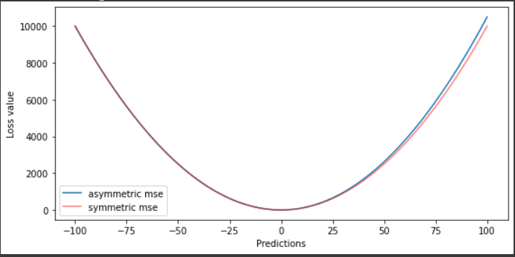
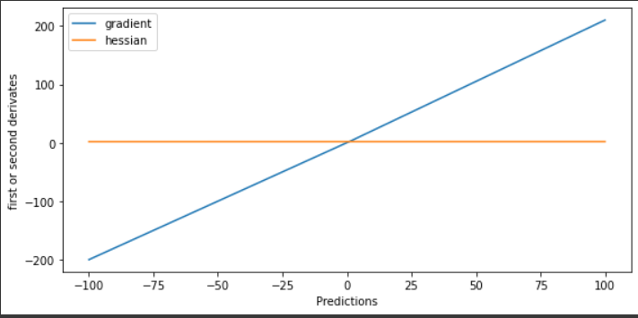
Custom objective and evaluation functions:
The penalty factor we used is p = 1.05 , it seems to be the convergence point no more significant change in MAE after this.
The penalty will be included in gradient as well as hessian and also in the evaluation function that will give us the mean squared loss.
This is the plot of the gradient of our custom objective function for regression (penalty included) – asymmetric loss vs the default objective function for regression – symmetric loss
Gradient – 1 order derivative of squared error.
This is the plot of the hessian of our custom objective function for regression (penalty included) – asymmetric loss vs the default objective function for regression – symmetric loss
Hessian – 1 order derivative of squared error.

Slide 27
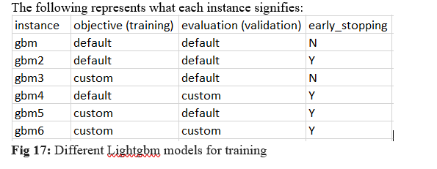
Creating lightgbm models:
Moreover, we create six instances of LightGBM model to get different insights and so that we can have results to compare with each other.
The model gbm6 is the model with custom objective and custom evaluation function where we have also applied early stopping. We observe that this model provides the least MAE on test set hence we use this model for further analysis.
Early Stopping to Avoid Overfitting: -
Is an approach to training complex machine learning models to avoid overfitting.
It works by monitoring the performance of the model that is being trained on a separate validation dataset and stopping the training procedure once the performance on the validation dataset has not improved after a fixed number of training iterations.(10).
The general rule is to take it to be 10% of your num_iterations which is by default 100 so no of early stopping rounds = 10.

Slide 28
Feature engineering:
We have introduced new features into the preprocessed AIS data These features are described in the following paragraphs and include North Sea distance and season feature.
North Sea distance
The number of fish in a particular region depends upon the depth of water column at that location. Depth is known to influence many factors on reef ecosystems for both coral and reef fish communities mainly due to light attenuation, changes in water temperature and pressure. The location of North Sea from which we calculate haversine distances to fishing locations is (56.88, 3.51). The distance captures the sense of relative number of fish that can be found at a particular fishing location.
Season feature
Since the case study focuses on Norway, hence we need to inculcate the fact that there are different fishing seasons. Cod fishing in Norway varies moderately throughout the year. High season is March to June and rest is considered low season. (For analysis purpose). We have considered 1 for high season and 0 for low season.

Slide 29
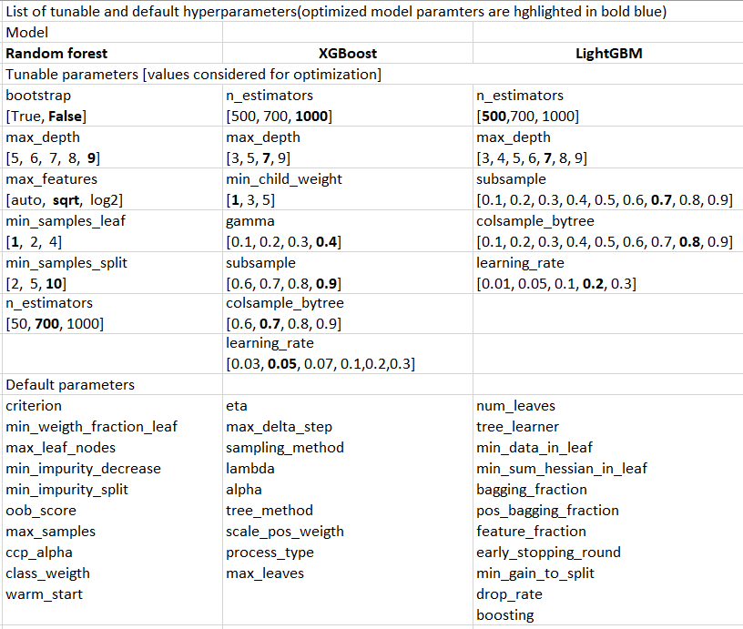
Model training and validation:
The data set was split into a training set (60%), a validation (20%) set and a test (20%) set. To divide data into these three categories, we randomly split each data point into the tree sets with the constraint that each set contains the same proportion of species codes. We use the stratify feature for this purpose. Also, the species code is a string format information to preserve its essence. For inputting to the model, we one hot encode the species code.
After training each of the three models: Random Forest, XGBoost, and LightGBM, we exposed it to the validation dataset for the estimation and optimization of its performance. The optimization is done by tuning the hyperparameters of the model using 3-fold cross-validation. The hyperparameters for each model are listed in the table.
The hyperparameters of all the models in different input data settings were tuned using RandomSearchCV method from the scikit-learn library
After optimizing the hyperparameters of the models, we tested its predictive capability on the test set.

Slide 30


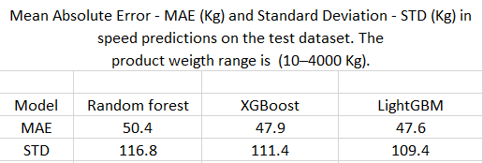
Performance metrics and results/errors:
Error measures (performance metrics) are vital component of the model evaluation. In this study we employed mean absolute error (MAE) and standard deviation of the absolute error (STD to evaluate the modelling approaches.
where n is the number of data samples, yi – single model prediction of product weight (Kg), xi – corresponding AIS record of product weight (kg), and 𝜇 – average of absolute error.
Results and limitations:
The models’ parameters are based on the historical AIS data (2001, 2021) from Norwegian fisheries. Any limitations of the underlying training data have been transferred to the models.
Also, the study does not incorporate the environmental variables and any political tensions that might also affect catch.

Slide 31
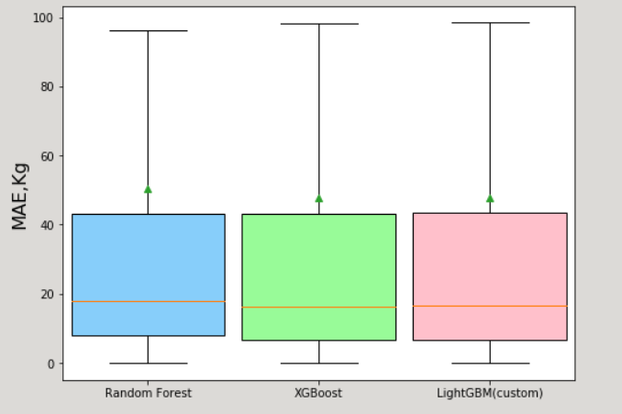
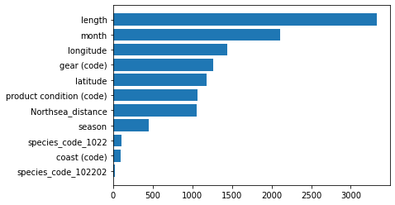
Results and Discussion
After 3-fold cross-validation of the models (with parameters in Table 2; see values highlighted in black. Mean absolute error (Kg) and standard deviation (Kg) in catch predictions on the test dataset can be found in Table 3. Based on the MAE scores presented in Table 3, it can be concluded that LightGBM model with our custom defined objective and evaluation function with additional features was better than other approaches with MAE up to 47.7 Kg and the standard deviation of 109.2 Kg on a test dataset.
The feature importance of the best performing model is presented in figure.
Feature importance:
Length was the most important feature to explain the catch variations in our dataset, followed by month, longitude, gear code, latitude, product condition code and distance from North Sea. Other features (coast code, species code and season) were found to be less important but still contributed to the predictive capabilities of the models.

Slide 32
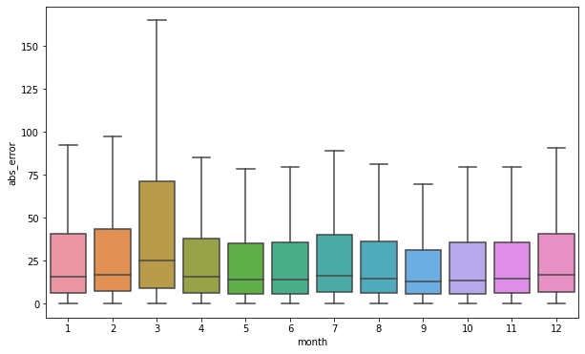
Inferences from results:
From the month analysis in figure we can see that the average error for all months except March is lower than 50kg, this indicates we need to pay more attention to transactions or activities happening in the month of march. For March the average absolute error is above 70kg.
From the gear analysis in figure we can say that we need to be more alert while fishing with gear/tools having code 20-undefined yearn, 41-ruser and 61-spinning rod as these are the gears for which the average error is higher than 50 kg. For the rest of the gears, it's less than 50 kg so it's fine.

Slide 33
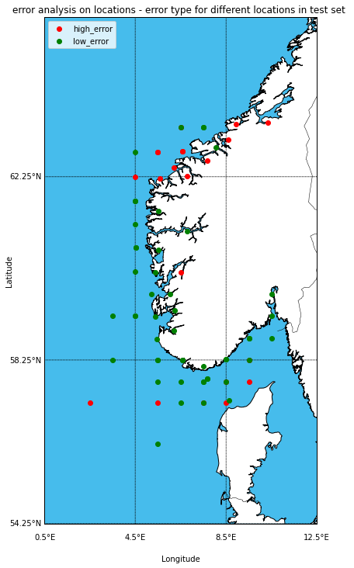
Geographical inference:
There are a total 72 unique fishing locations for south Norway (cleaned data - test set) and we set the threshold to be 50 kg, that is if the error in that region is higher than threshold, it is said to be a region with high error whereas the region with error lesser than threshold is a region of low error. This can signify where they have trustworthy people and where they do not. From the location analysis we can say that we need to pay more attention to the activities of two locations one is north region of North Sea bounded by longitude 4.5E and 8.5E above the latitude 62.25N on the coastline of Norway and the other is just above the coastline of Denmark as these fishing locations have a cluster of red dots indicating that these are the regions of high error. Majority of the high errors are in the region below Trondheim to Haugsbygada

Slide 34
Conclusion:
The Fish catch has two main importance that are food security needs and generation of export revenue. In this study we have investigated a possibility of predicting catch using historical AIS data.
First, we have analyzed AIS data retrieved from Directorate of Fisheries, Norway, and then we trained three machine learning models on the enhanced AIS data (extra information about North Sea distance and the season).
Then we evaluated the models’ performance on the validation data to tune the hyperparameters for the best model. Next, we have exposed the models to test data to evaluate their predictive capability. The main results of this study show that
(1) Supervised machine learning methods can be used for predicting catch (10 − 4000 kg) with mean absolute error up to approximately 47.6Kg in average.
(2) Majority of the high errors are in the region below Trondheim to haugsbygada. The month of March experienced the highest error, along with these certain gears like 20-undefined yarn, 41-ruser and 61-Spinning rod have also resulted in high error with respect to others.
(3) The LightGBM, model built on custom objective and evaluation functions with additional features, is a better modeling approach in a view of the considered dataset and modelling techniques. (3) geographical information such as a distance from the predefined places (North Sea) can be engineered to enhance the predictive capabilities of the models.
The presented machine learning approach to catch prediction could be considered as a source of additional and complimentary information for tactical planning (months ahead) of vessel trips in the North Sea as well as to support development of new strategies that can include the effect of climatic variables as well. Future work should focus on supplementing existing AIS data with the data from the environmental data, development and training of the models based on a continuously growing dataset.

Slide 35
References:
https://www.statista.com/statistics/643484/per-capita-consumption-of-fish-and-fish-products-in-norway/
https://www.statista.com/statistics/665969/export-value-of-seafood-from-fisheries-and-aquaculture-in-norway/
https://ieeexplore.ieee.org/document/1519023
https://journals.ansfoundation.org/index.php/jans/article/view/1252
https://content.iospress.com/articles/journal-of-ambient-intelligence-and-smart-environments/ais210604
https://ndpublisher.in/admin/issues/EAv63n4e.pdf
https://cdnsciencepub.com/doi/abs/10.1139/f82-036?journalCode=cjfas
https://www.sciencedirect.com/science/article/abs/pii/S0034425710000295?via%3Dihub
https://www.mdpi.com/2071-1050/13/16/9124
https://link.springer.com/chapter/10.1007/978-3-030-38081-6_7
https://cdnsciencepub.com/doi/abs/10.1139/f82-036?journalCode=cjfas
Links to data related information can not be provided because the data is confidential.

